Slide 1
Family and Consumer Sciences (FCS)
2014-15

Slide 2
Fcs Courses at Wilson High School
9th Grade | 10th Grade | 11th Grade | 12th Grade
Investigating Foods Understanding Relationships Fashion and Interior Design * Course has Prerequisite for admittance | Food Preparation Understanding Relationships Child Development Fashion and Interior Design Textile and Clothing Construction | Food Preparation Chef's Course Understanding Relationships Child Development Early Childhood Fashion and Interior Design Textile and Clothing Construction Advanced Clothing Construction | Food Preparation Chef's Course Understanding Relationships Child Development Early Childhood Fashion and Interior Design Textile and Clothing Construction Student Instructional Aide Advanced Clothing Construction

Slide 3
Investigating Foods – 9th Grade Only
Credit 1.0
Learn about the science of food as you bake and cook a variety of culinary delights.
Explore how foods play an important part of each person’s life and how health and well-being is impacted by one’s food choices.
In addition to food preparation, students will learn about food safety in a culinary environment.

Slide 4
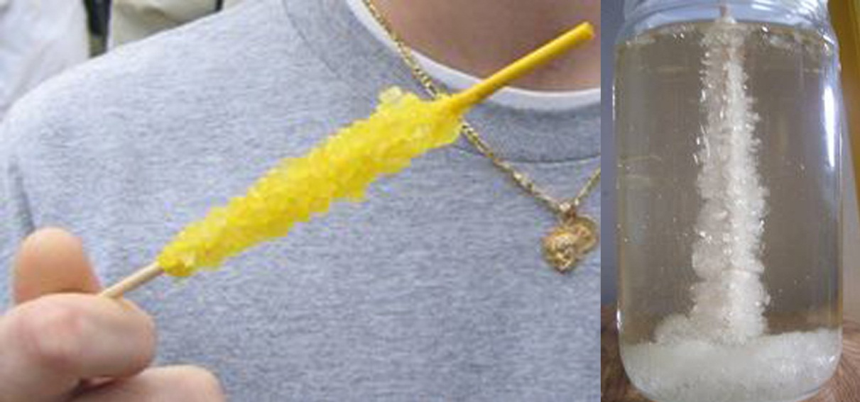
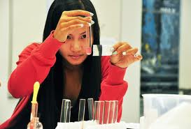
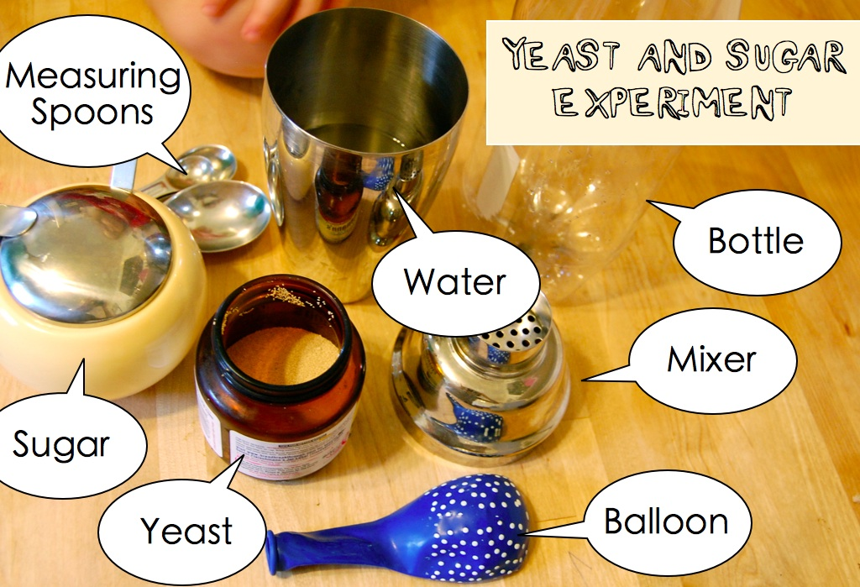
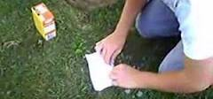
Food Science experiments with every lab
Diffusion & Osmosis
Making Rock Candy
Baking soda
Bombs

Slide 5
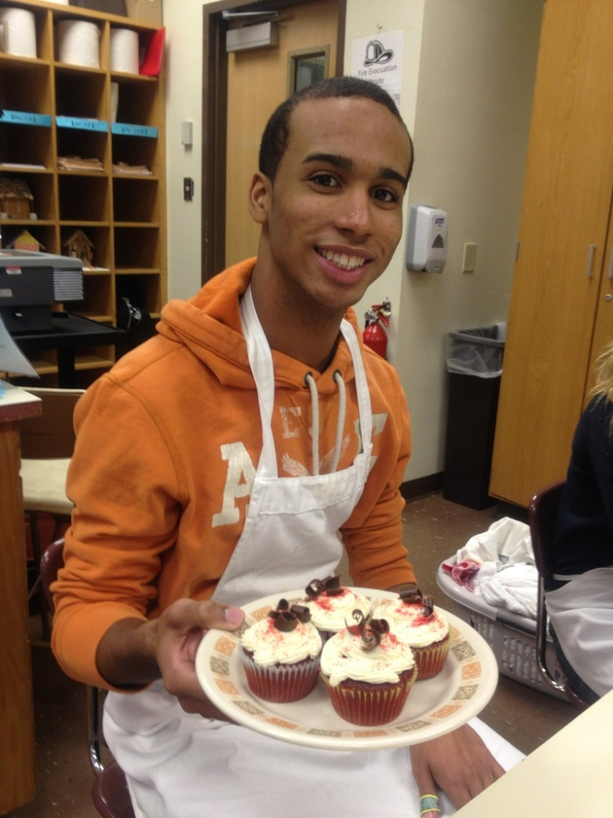
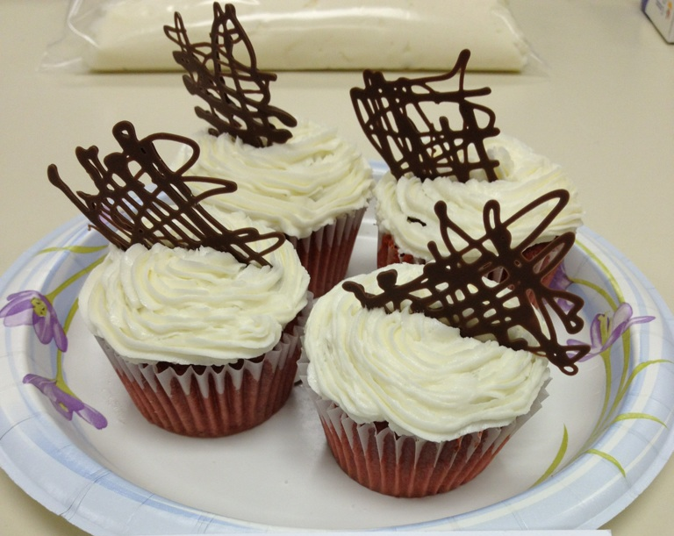
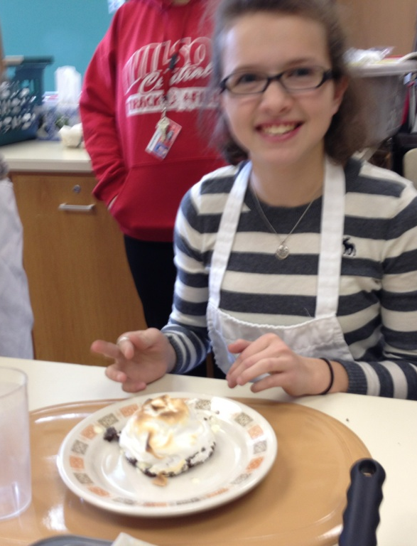
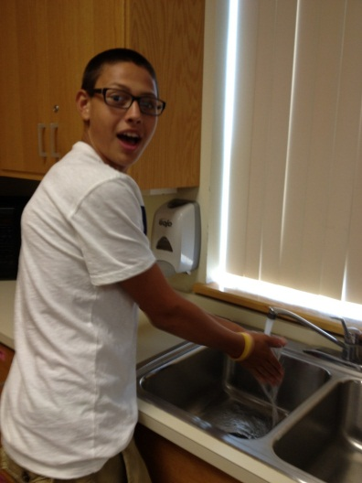
Use your new knowledge to cook some great food
….. And take turns cleaning up too

Slide 6
Understanding Relationships – 9-12
1 Credit
This course is about establishing good relationships with friends, family, teachers, boy/girl friends, and eventually husbands and wives.

Slide 7
Students will learn about……
Personal and individual differences
Communication
Current teen issues
Insight on preparing and adjusting for marriage
Parenting Decisions
Pregnancy and childbirth

Slide 8
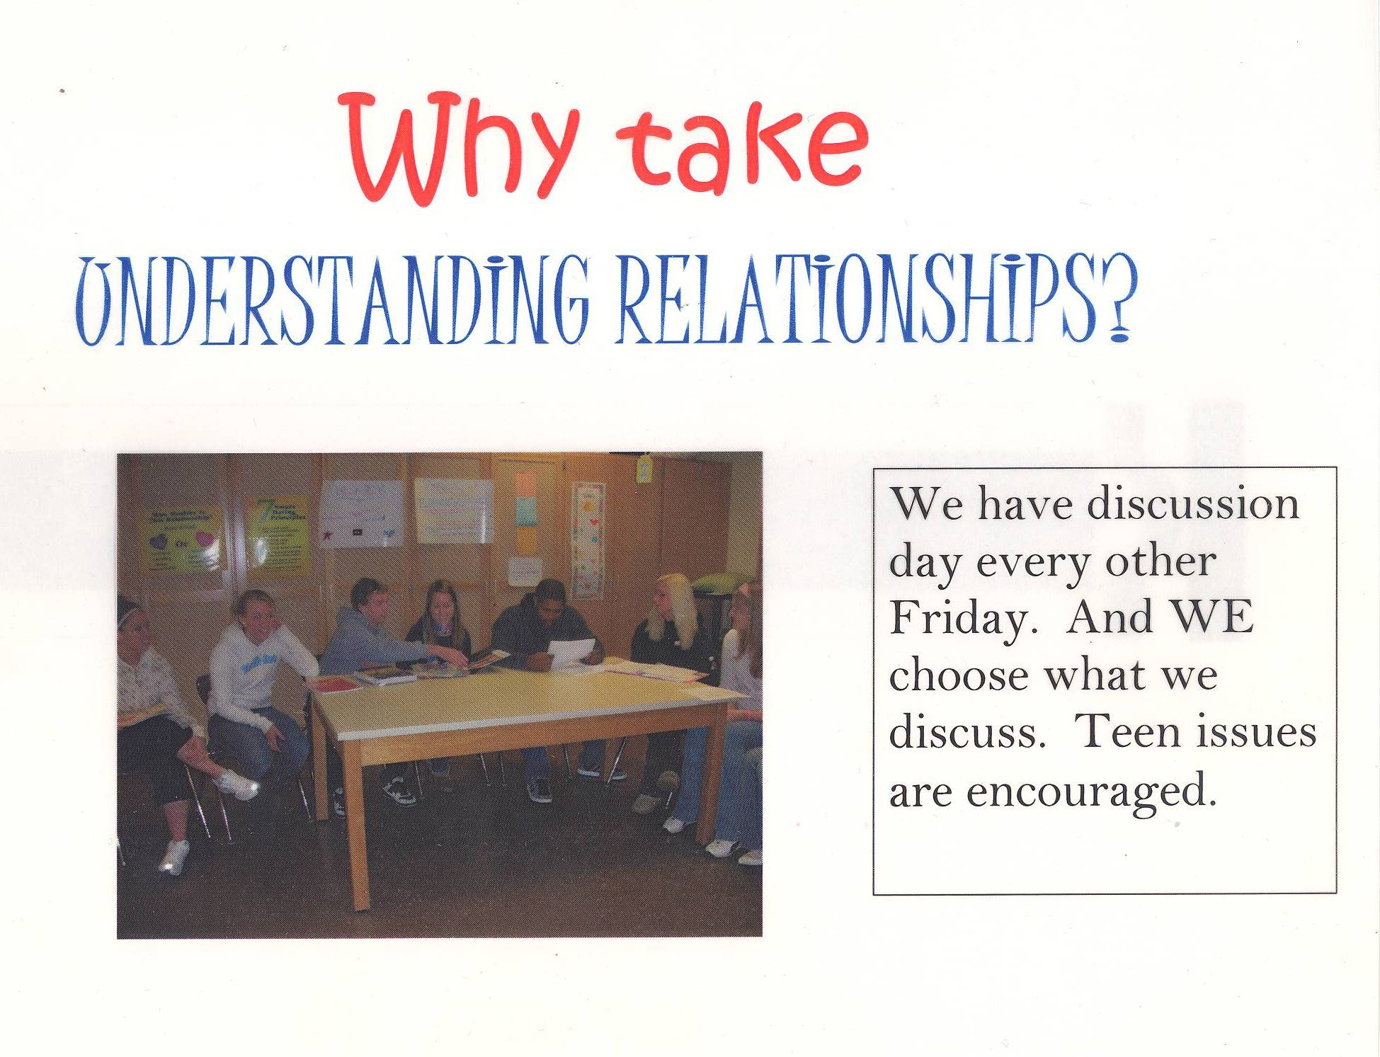

Slide 9
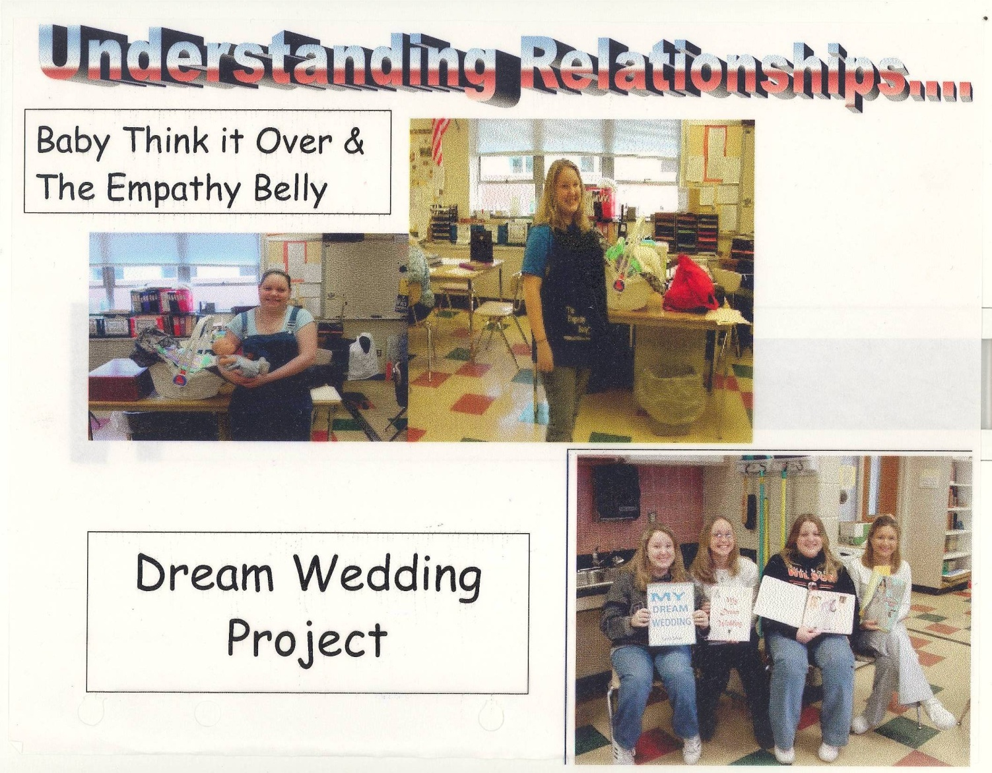

Slide 10
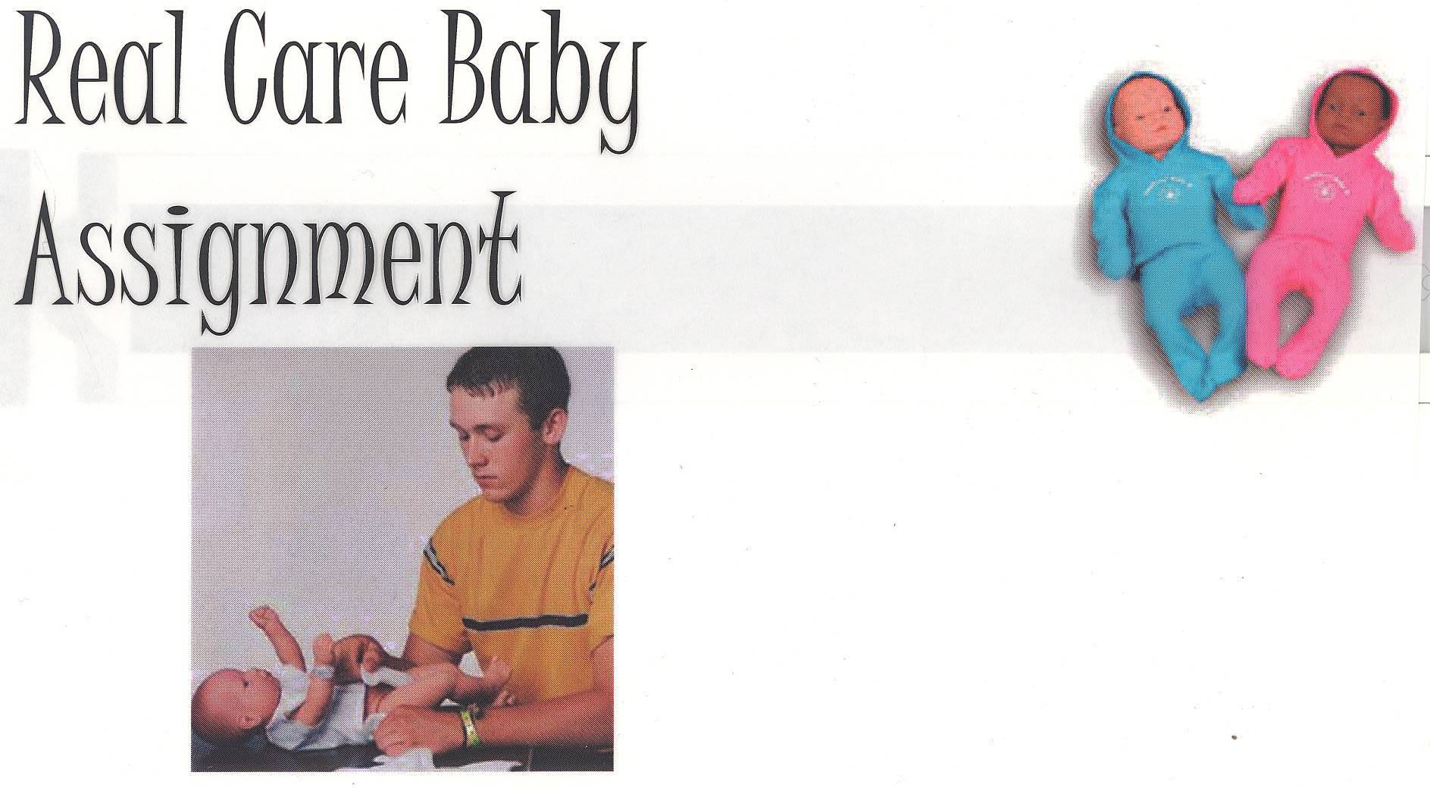
Take a Baby home for the night!!

Slide 11
Fashion and Interior Design – 9-12
Explore the world of fashion and interior design!
Learn about clothing and textile design, fashion history, fabrics, basic sewing techniques, dressing for your body type and choosing colors that complement you.
Interior design – Includes the basics of decorating, the use of color, texture, and patterns to create a mood in a room.
Students will design and create projects, hear guest speakers, go on field trips and explore career options.

Slide 12

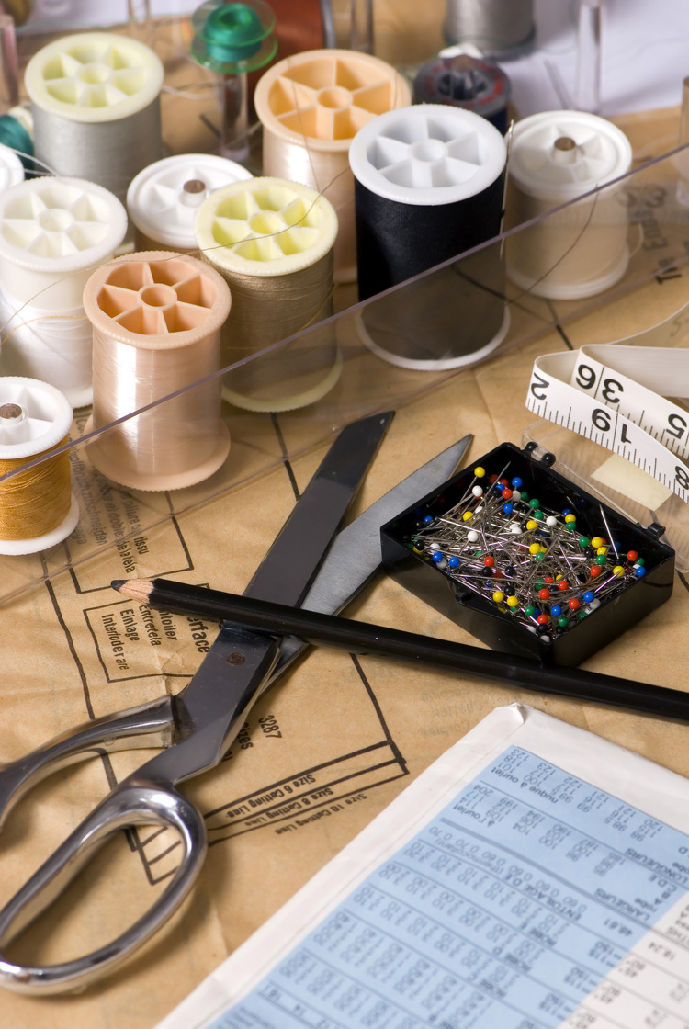

Slide 13
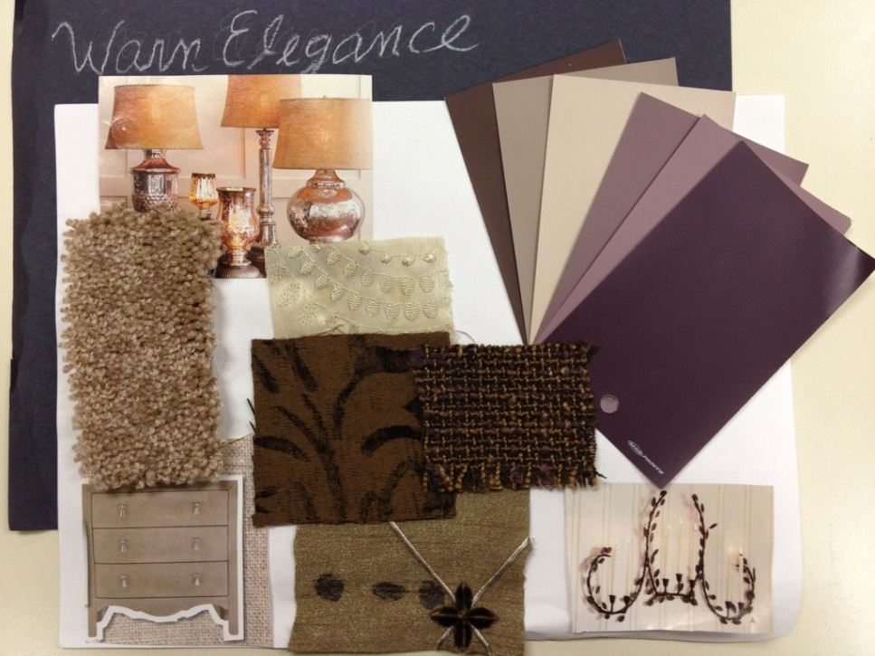

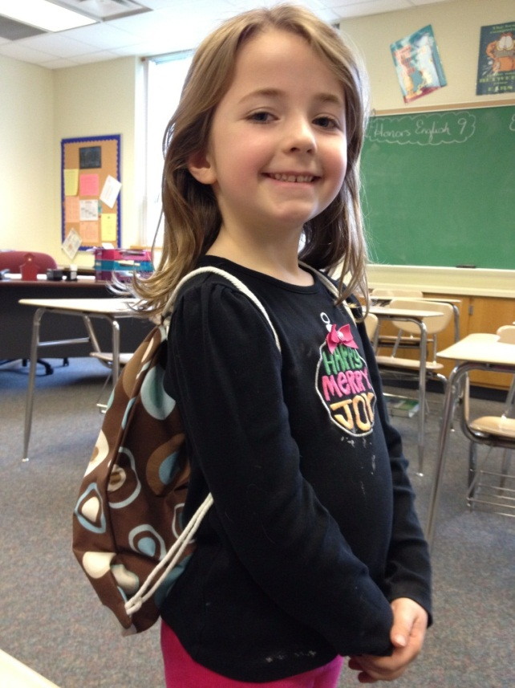
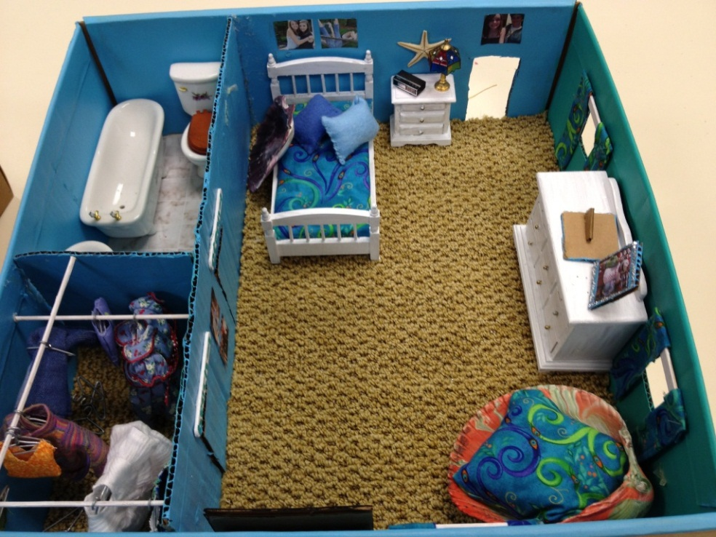
Mood Boards
Careers
Sewing Basics
Service Projects
Scale Models

Slide 14
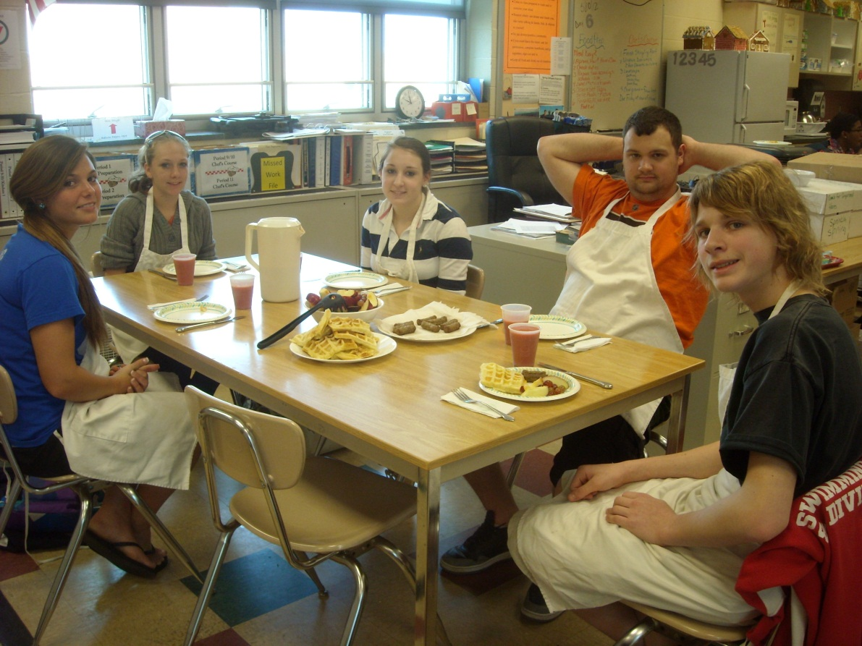
Food Preparation – 10-12
1 Credit
Enjoy a meal cooked at school

Slide 15
Food Preparation Topics
Quick breads Yeast breads Cake Cake decorating Cookies Pies Gingerbread houses Microwave Grains Vegetables Salads | Pasta Soups Casseroles Poultry Red meats Vegetarianism Milk and Cheese Fruit Eggs Candy Meal planning

Slide 16
Additional topics…….
Dietary Guidelines
Healthy snack
Nutrients
Safety and sanitation
Kitchen equipment and recipes
Cooking terms and measuring
Food Borne Illnesses

Slide 17
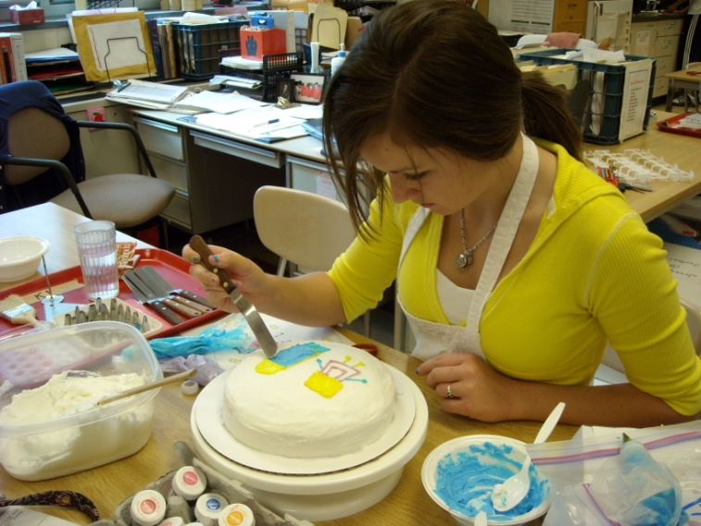
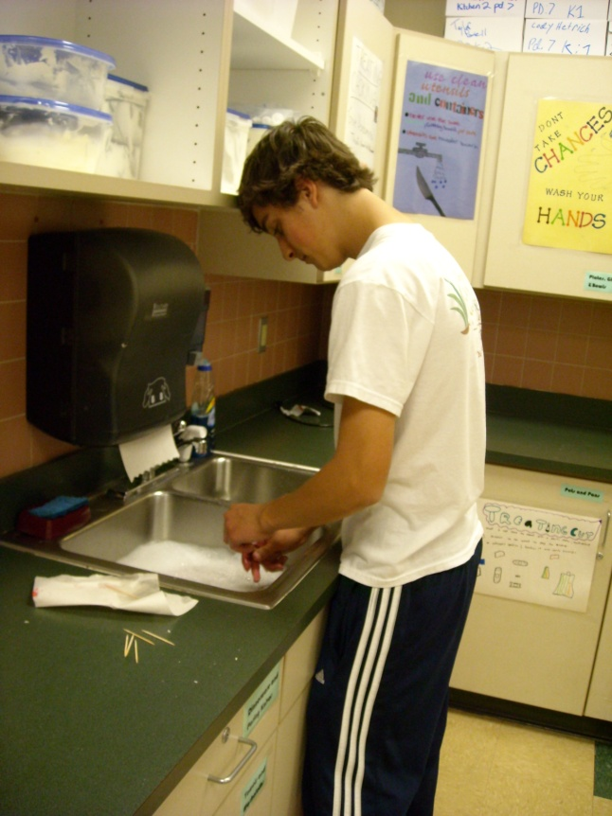
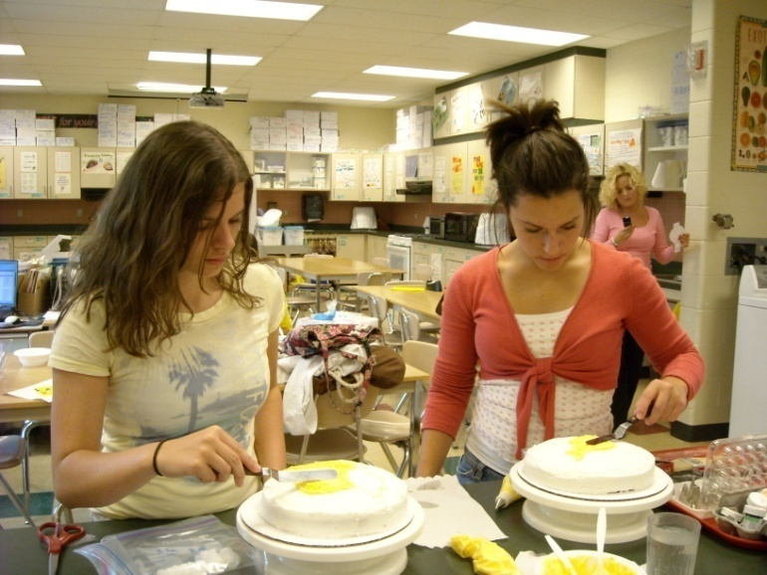
Decorating cakes

Slide 18
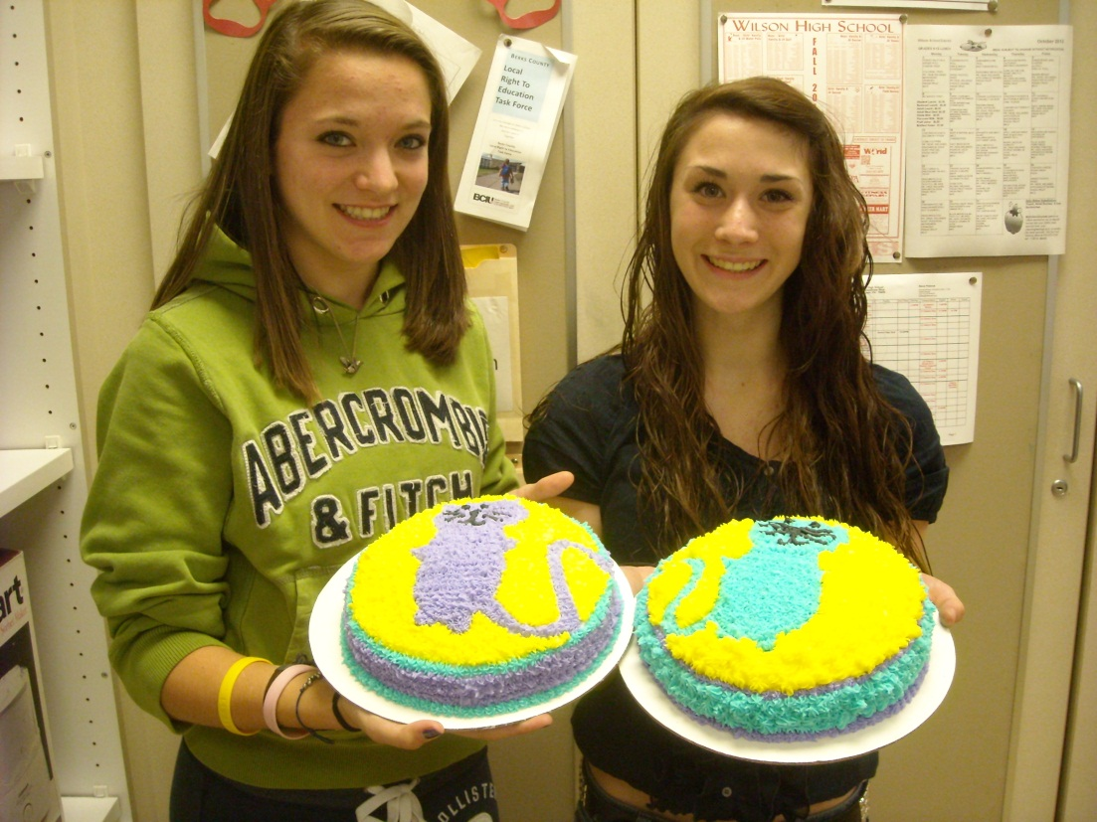
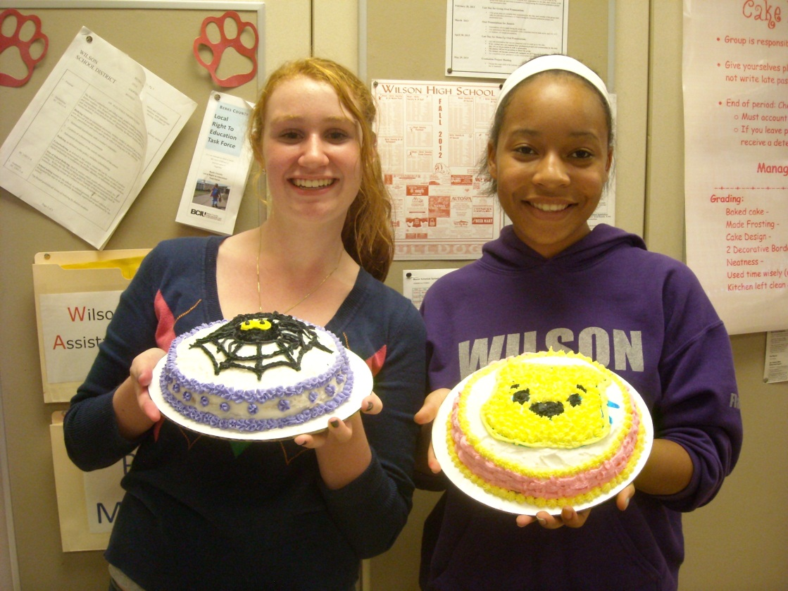
More Cakes!!!!!!!

Slide 19
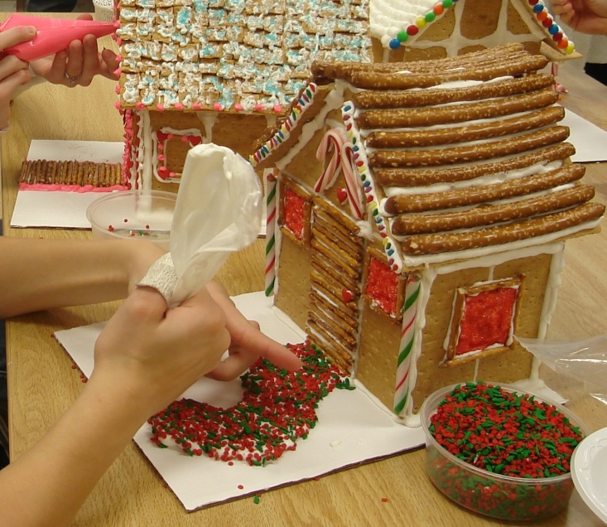
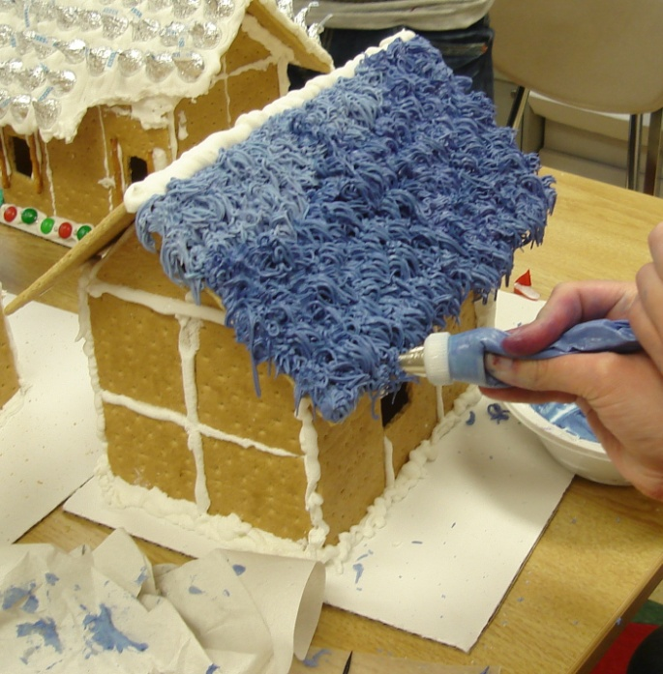
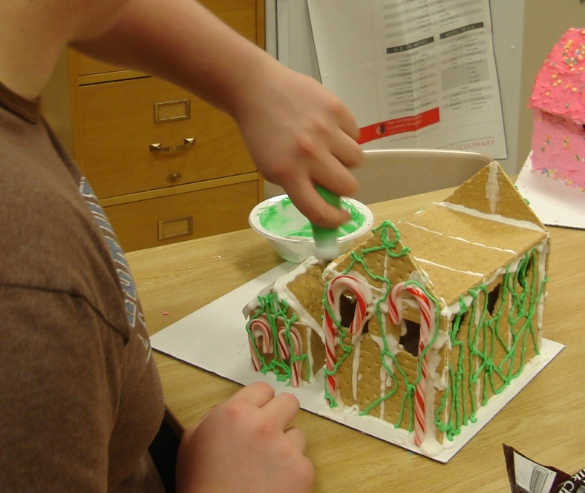
Gingerbread house construction

Slide 20
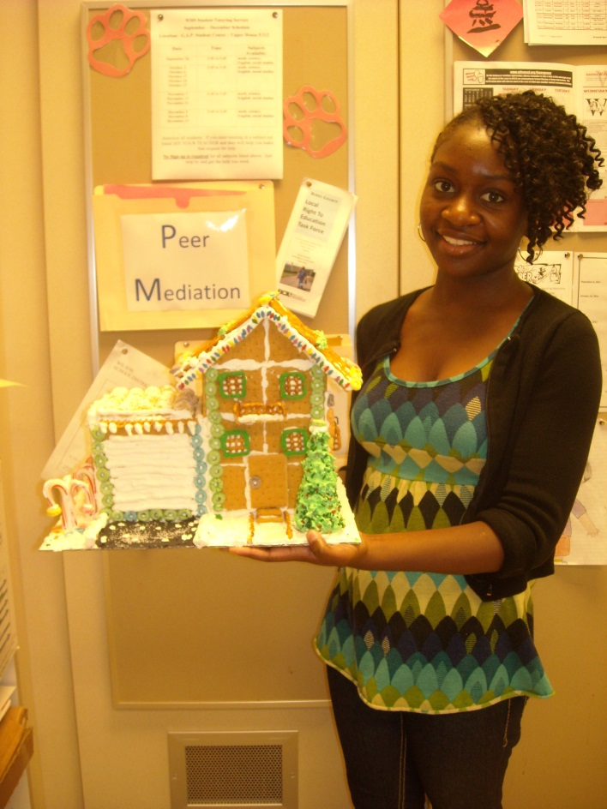
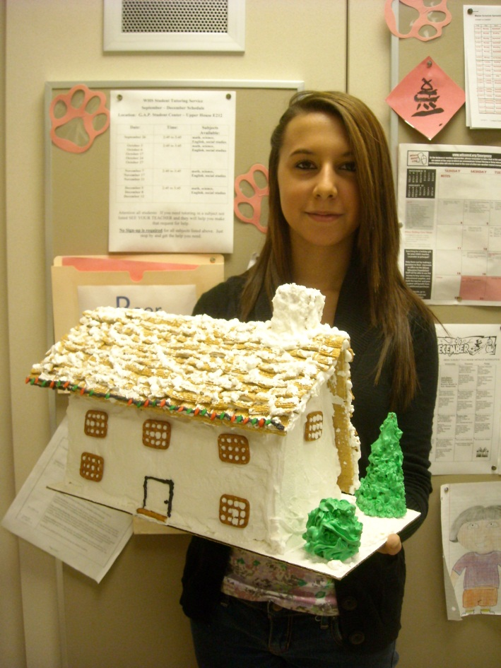
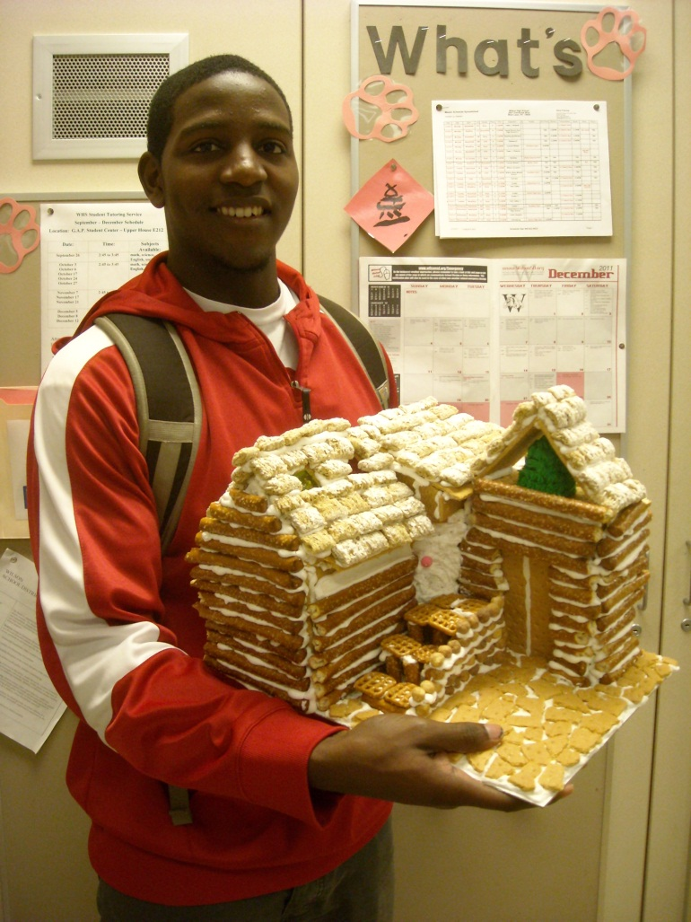
Finished Houses!!!!!

Slide 21
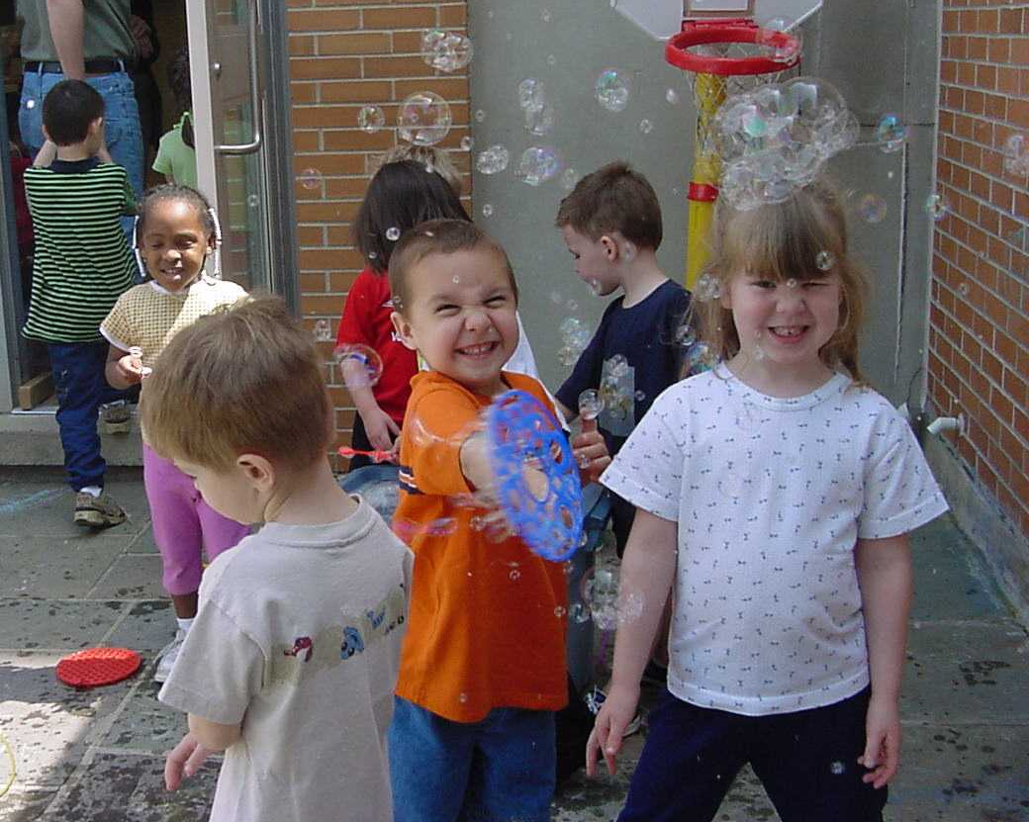
Child Development – 10-12
1 Credit

Slide 22
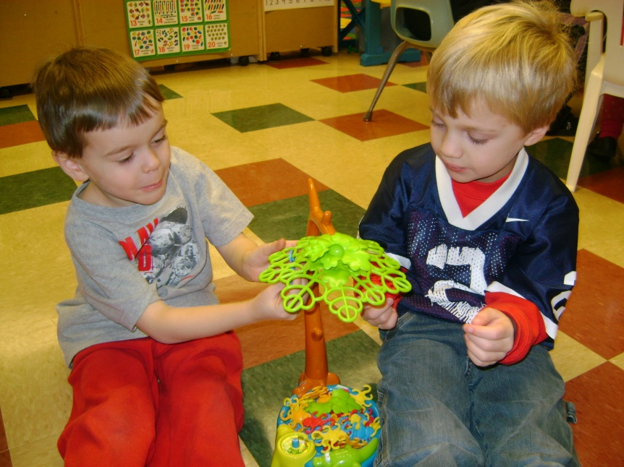
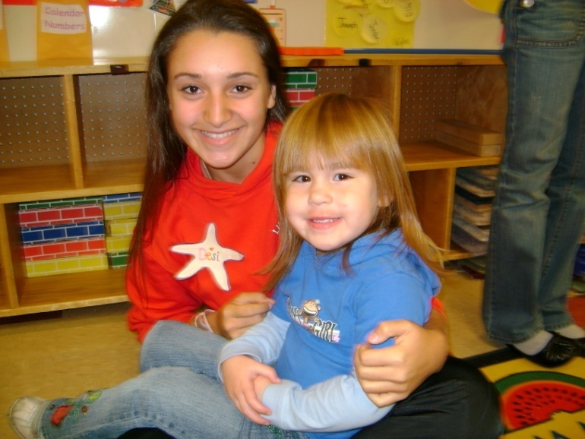
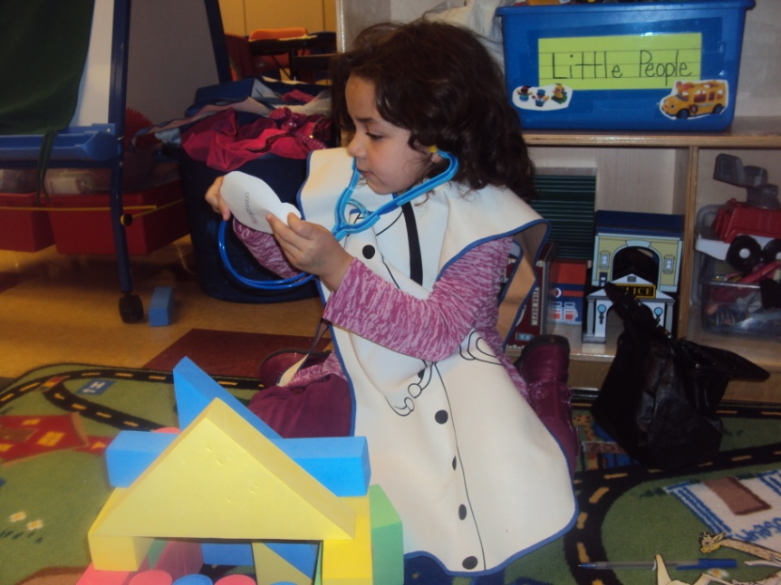
Social Development
Emotional
Development

Slide 23
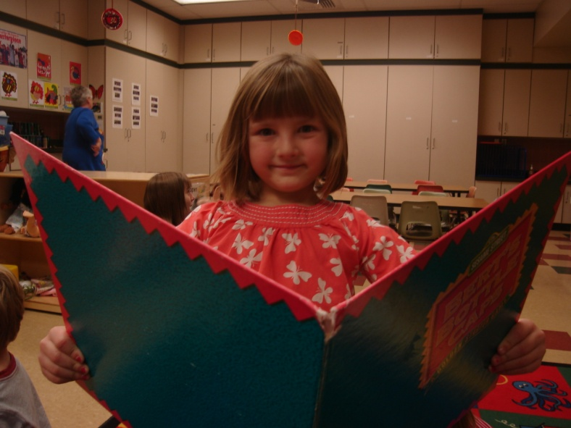
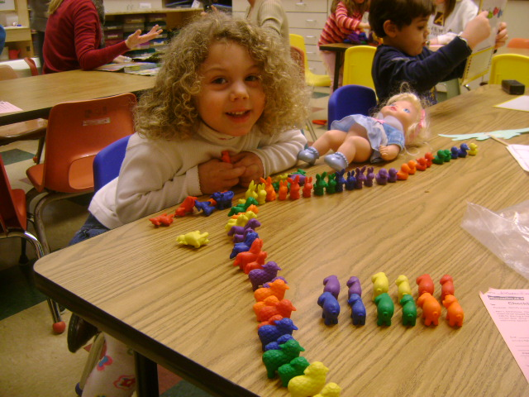
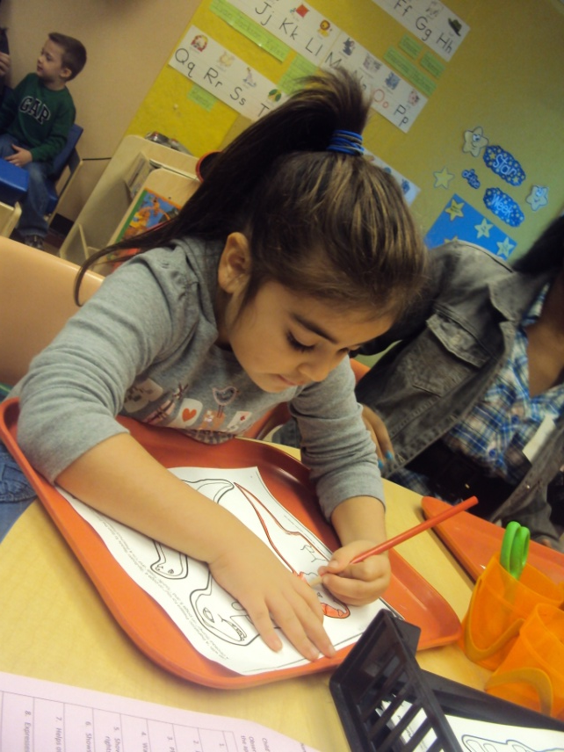
Language
Development
Cognitive Development

Slide 24
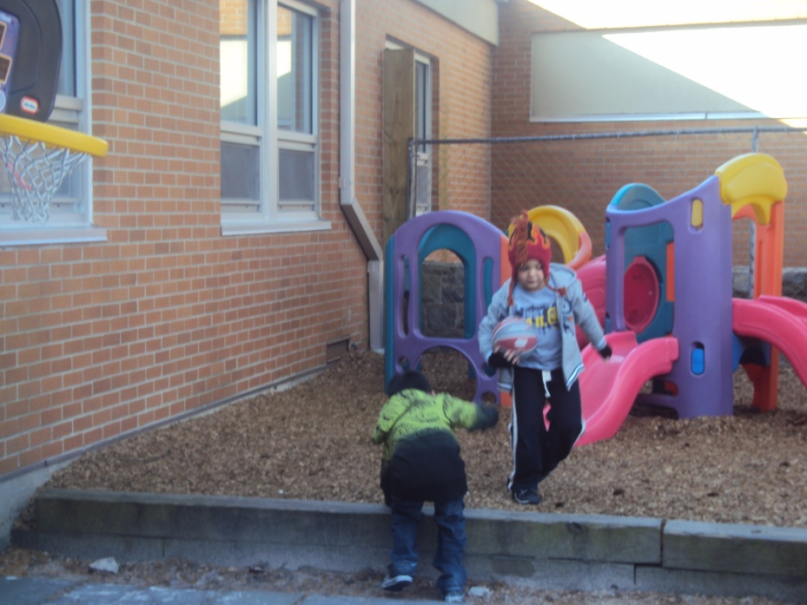
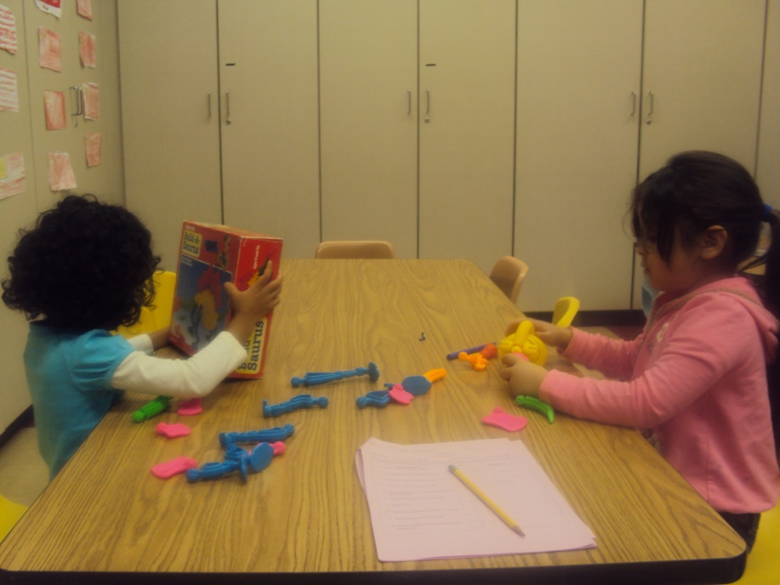
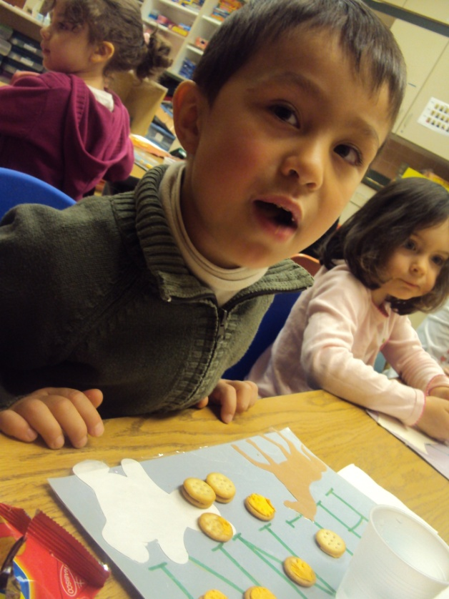
Fine motor and gross motor skills

Slide 25
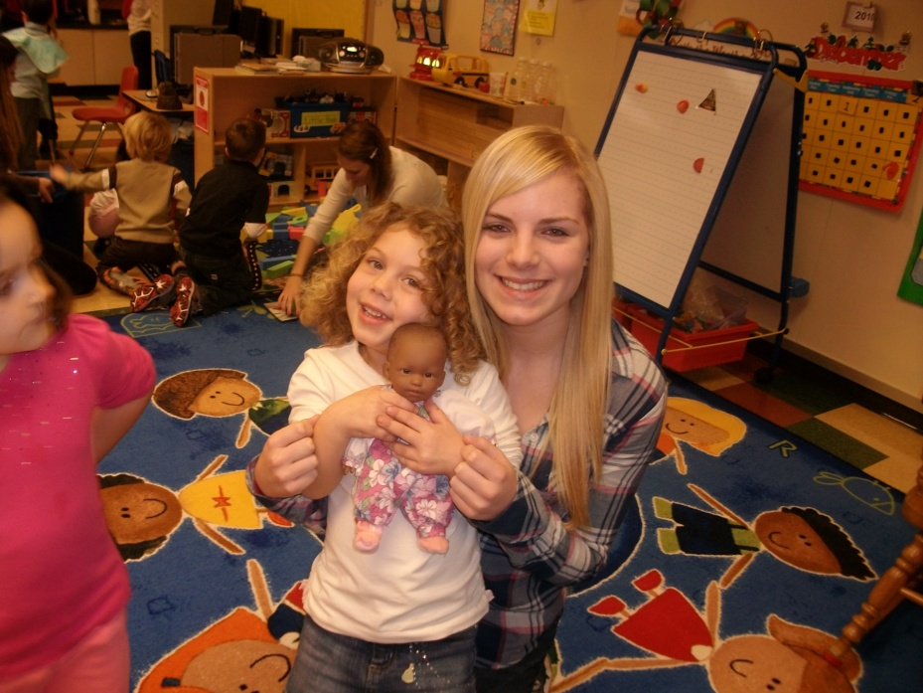
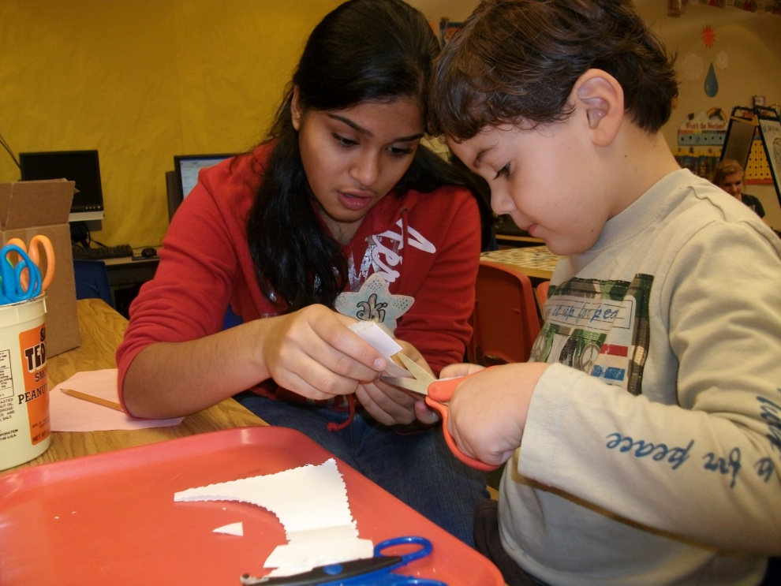
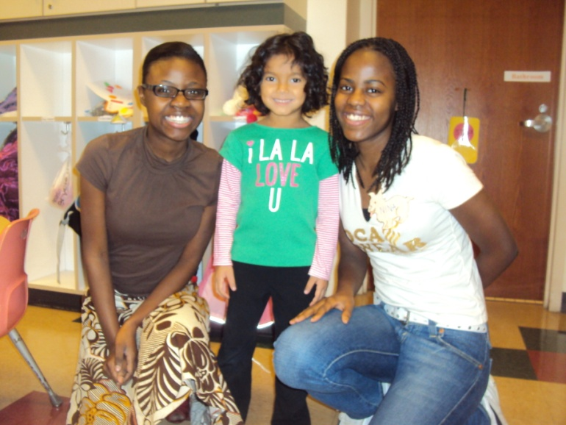
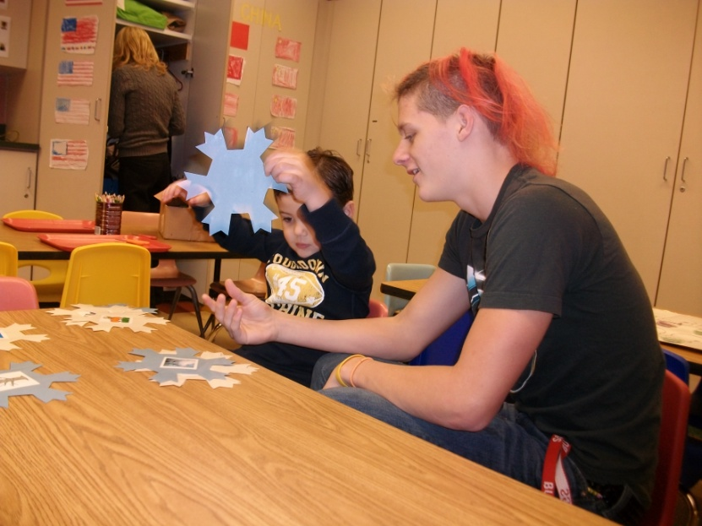
Work weekly with preschool child

Slide 26
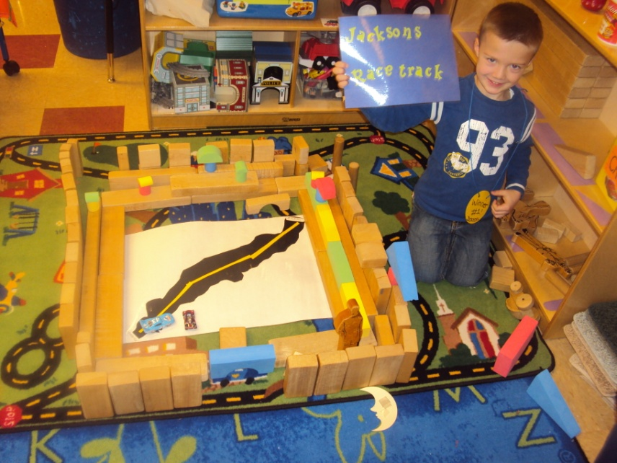
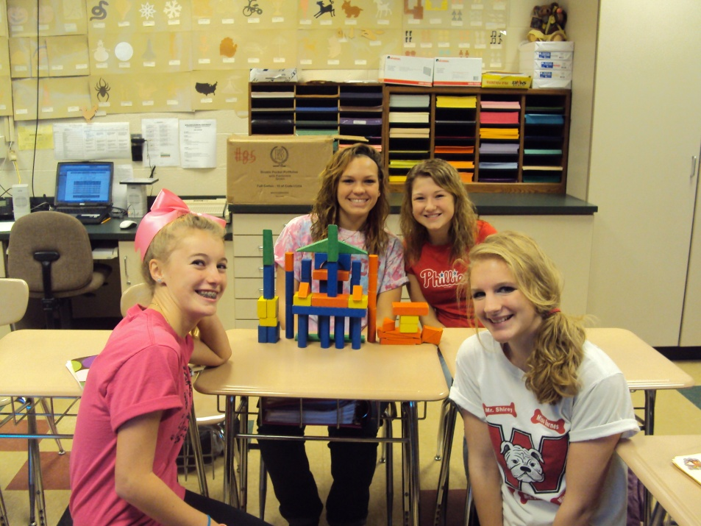
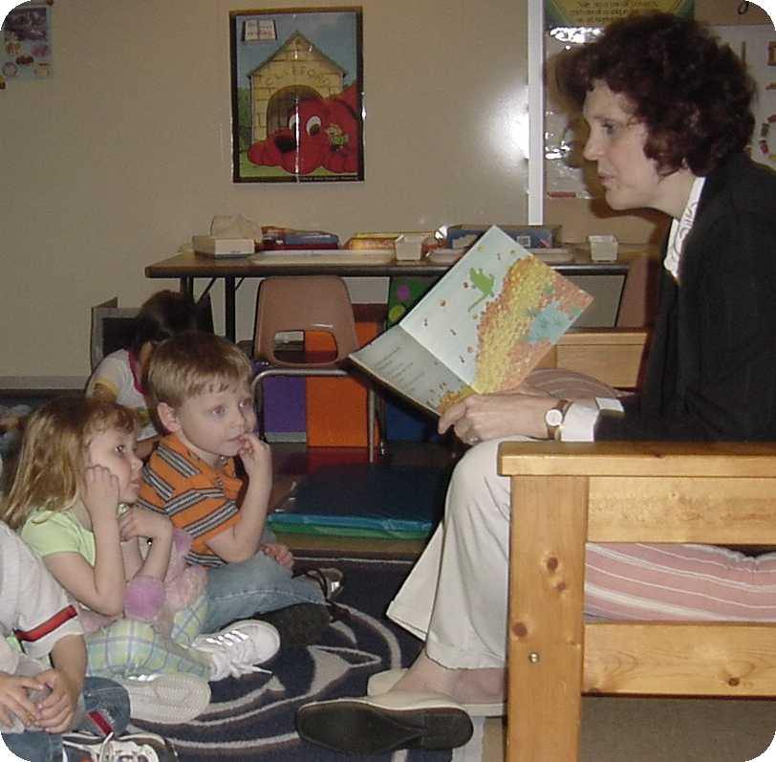
Block Play Project
Storytelling Project

Slide 27
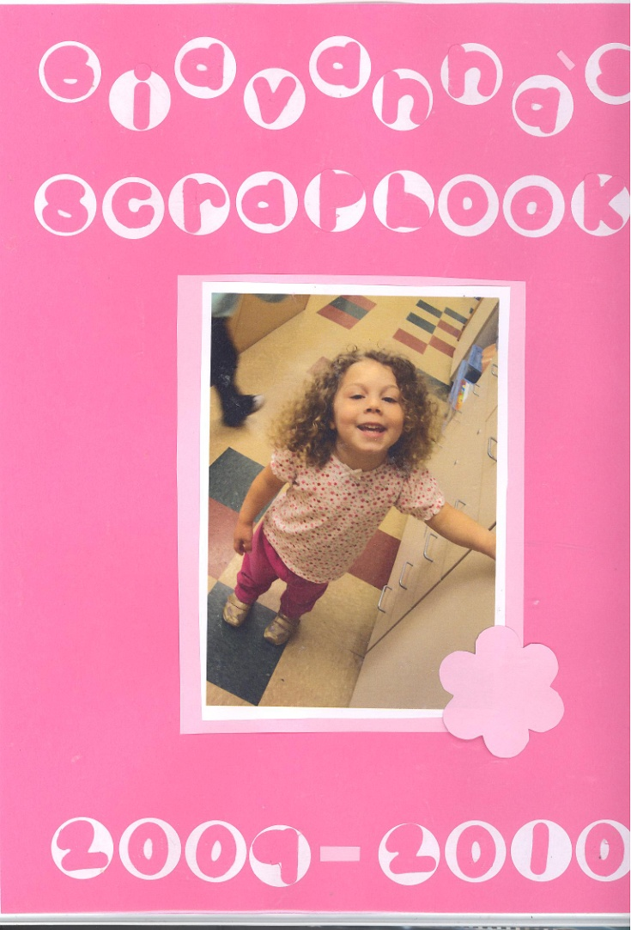
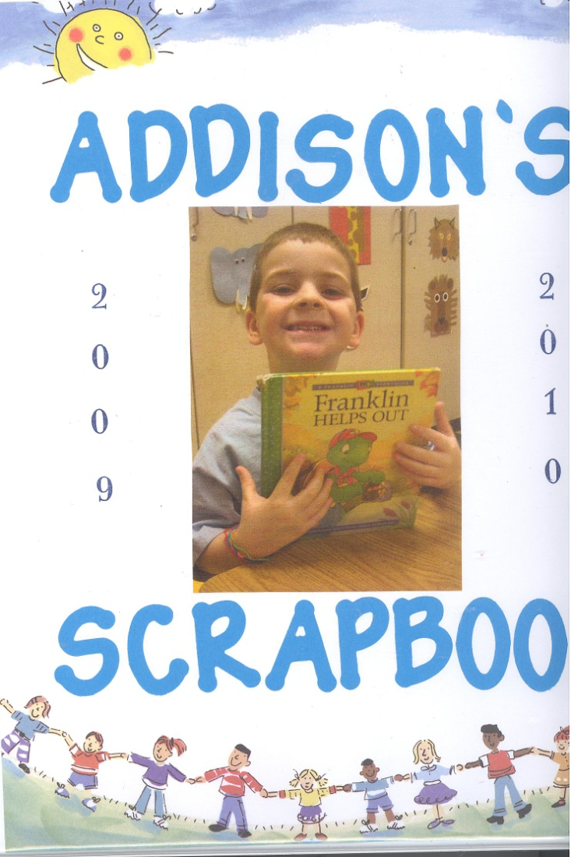
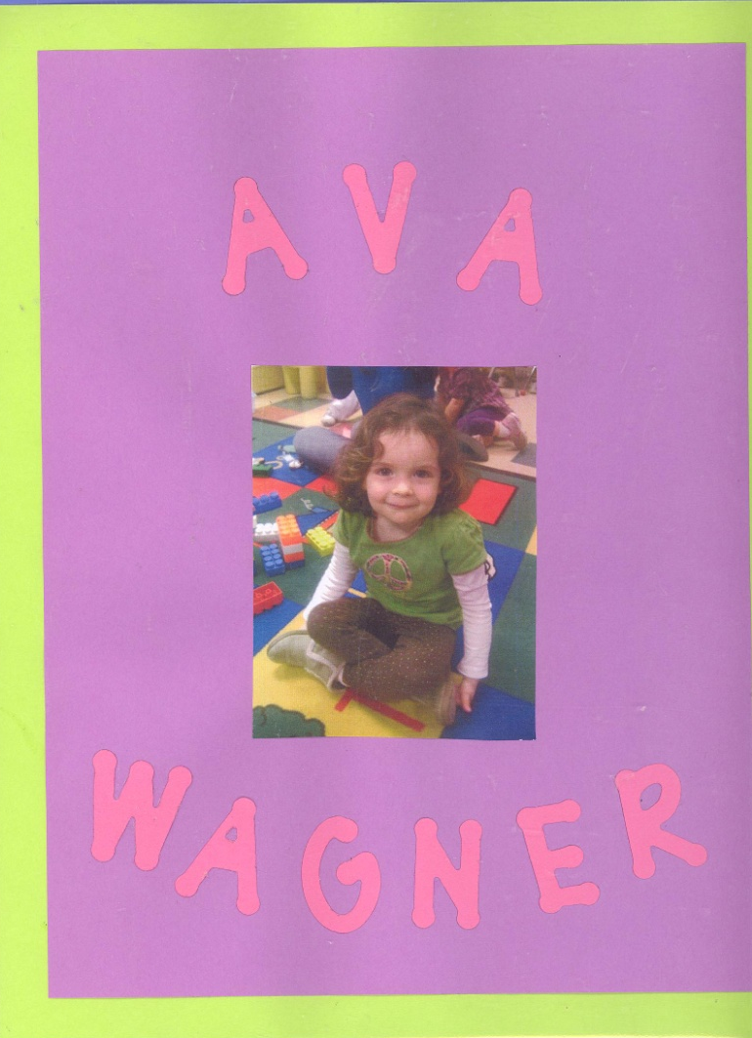
Final Project – Developmental Portfolio

Slide 28
Textile and Clothing Construction 10-12
Prerequisite: Fashion and Interior Design
1 Credit
Are you interested in careers in clothing and textiles?
Do you want to learn how to sew and develop your creative skills with fabrics?
Create projects using commercial patterns and supplies to meet your needs and fashion sense.
Students will be involved in flat pattern measuring, fitting methods, pattern drafting and sewing techniques.

Slide 29
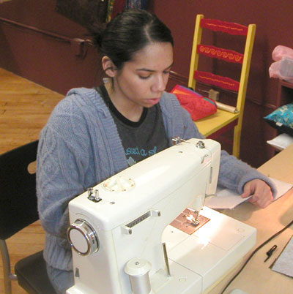
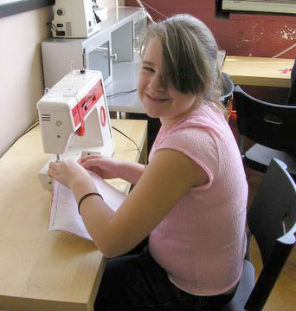
Students are required to purchase supplies for this class; therefore, you will incur individual costs for projects.

Slide 30

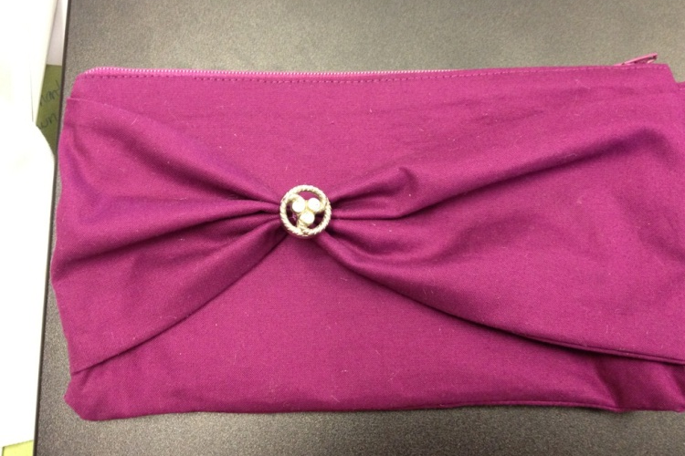



Students working on textile, costumes, accessories, fiber art projects.

Slide 31
Advanced clothing construction 11-12
Prerequisite: Textile & Clothing Construction
1 Credit
Are you interested in careers in clothing design or tailoring?
Do you want to learn advanced sewing techniques like sewing evening wear, fitted complex garments, pattern drafting and draping?
In this class you will select projects to work on challenging projects that advance your sewing skills.
You will learn to design and draft your own patterns.

Slide 32



Advanced clothing construction 11-12

Slide 33


Chef’s Course 11-12
Prerequisite: Food Preparation
1 credit

Slide 34
Foreign foods we Make!
South America
Mexico
Middle East
Israel
Africa
Greece
Spain
Italy
British Isles
Germany
France
Scandinavia
Russia
India
China
Japan

Slide 35



Entertaining Unit!!

Slide 36

Gingerbread houses

Slide 37


Practice your skills at cake decorating!

Slide 38


Early Childhood – 11-12
Prerequisite: Child Development
2 Credits – Double Period
Work with elementary teacher every other day

Slide 39



Ways to Keep Children Healthy and Safe

Slide 40

Department of Welfare Regulations
How many regulations did they break?

Slide 41


Child’s Literacy

Slide 42


Bulletin Boards

Slide 43



Theme Box project
Develop 8 activities based on one theme

Slide 44

Field Trips to early Learning Centers
Kutztown University
Reading Hospital Child Development Center
The Goddard School
Montessori Country Day School
Vallone’s Family Child Care
Millersville University

Slide 45

Final Project
Career Portfolio

Slide 46

Student Instructional Aide – 12th only
Prerequisite: Senior and Application
1 Credit

Slide 47


Die cut Project

Slide 48



Bulletin Boards are Fun

Slide 49


Instructional Games

Slide 50

Storytelling Project

Slide 51

Professional Portfolio
Final Project

Slide 52
See You Next year!
Mrs. Bednarik
Mrs. McTish
Mrs. Mohr
Mrs. Moyer

